Slide 1
Course Introduction
Fall 2021
Dr. Shannon Quinn

Slide 2
What this course *is*
Picks up where 3360 Data Science I left off
A deeper dive into modeling and quantitative analysis methods
“What to do when you’ve already tried Option A”
Combination of theory and practice using latest data science tools and techniques

Slide 3
What this course is *not*
Introduction to probability and statistics
Should be able to derive Bayes’ Theorem from law of conditional probability, no sweat
Don’t need to prove the SVM dual, but should be aware of it and its function
Introduction to programming
No Python experience required, but are expected to pick it up FAST (i.e., you’ve programmed before, just not in Python)
Workshop 0 (Monday) is a Python crash-course

Slide 4
What?
Course title: Data Science II
CSCI 4360 (for undergraduates)
CSCI 6360 (for graduates)
Course textbooks: none required
Lots of recommended books—check out the course website
Will continue to update with more references
Python: 3.x
Details to come

Slide 5
Who?
Dr. Shannon Quinn (that’s me)
2008: B.S. in Computer Science from Georgia Tech (go Jackets!)
2010: M.S. in Computational Biology from Carnegie Mellon
2014: Ph.D. in Computational Biology from joint Carnegie Mellon-University of Pittsburgh Ph.D. Program in Computational Biology (CPCB)
Research areas
Biomedical imaging
Computer vision
Distributed computing
Biosurveillance
Data Science + Public Health

Slide 6
When and Where?
Lectures
Tuesdays and Thursdays: 2:20 – 3:35pm, Physics 0303
Mondays: 3:00 – 3:50pm, Forest Resources-4 0517
Office Hours
Boyd 638A
TBA / Discord
TA: TBA
Office Hours: TBA

Slide 7
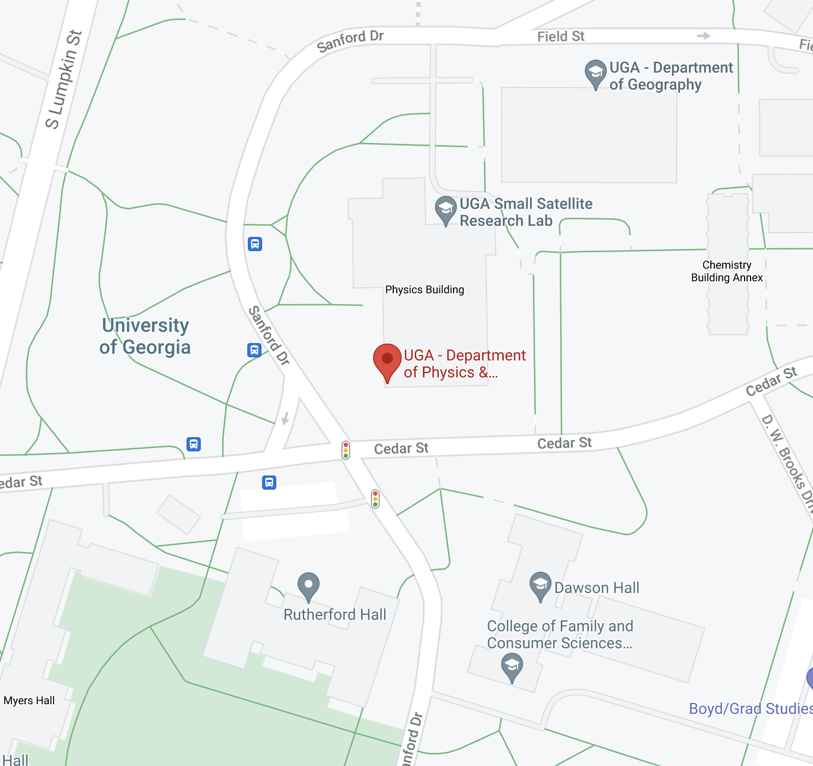
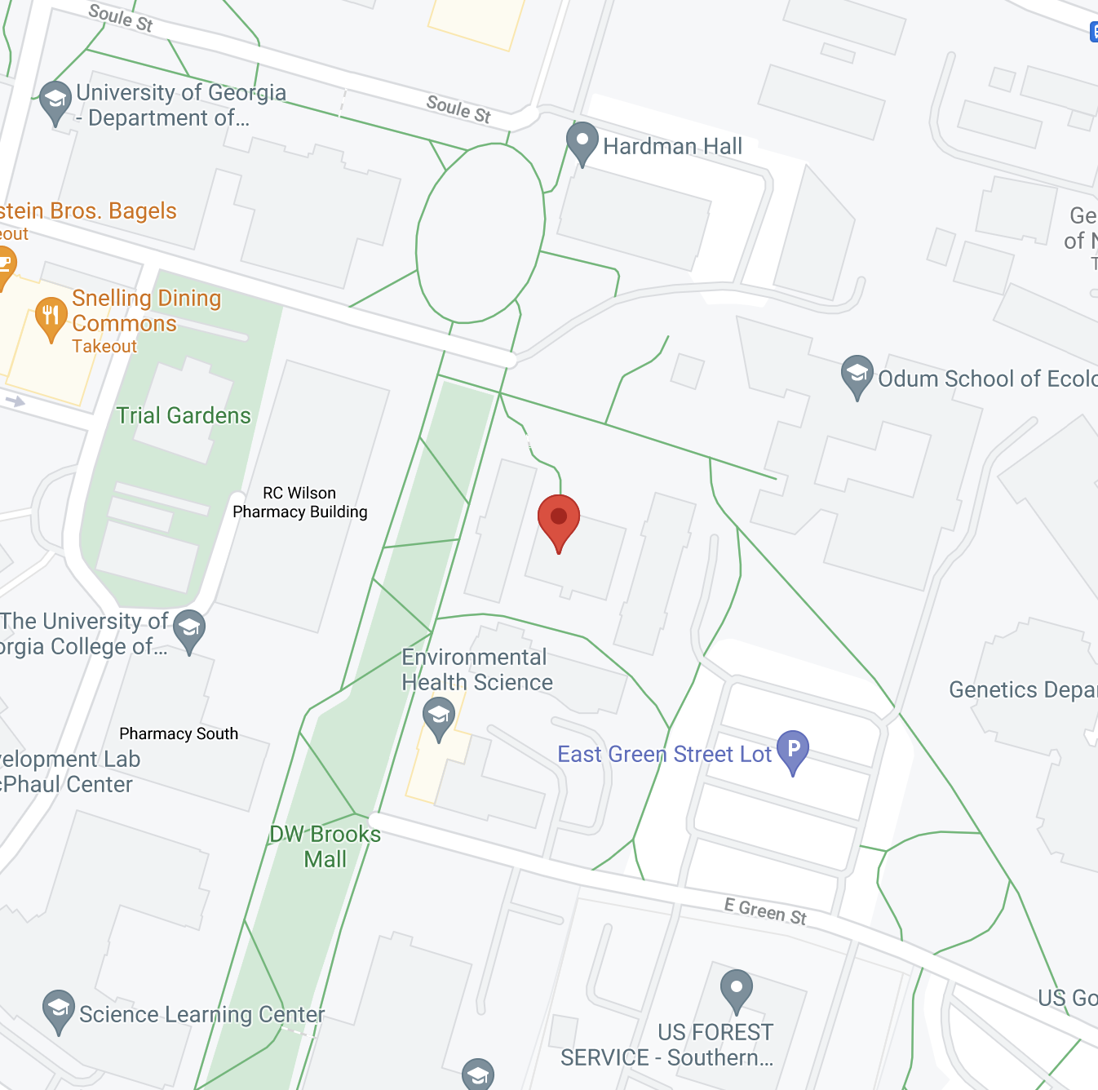
When and Where?
Tuesday / Thursday
Monday

Slide 8

How?
Course website / syllabus: https://eds-uga.github.io/csci-x360-fa21/

Slide 9
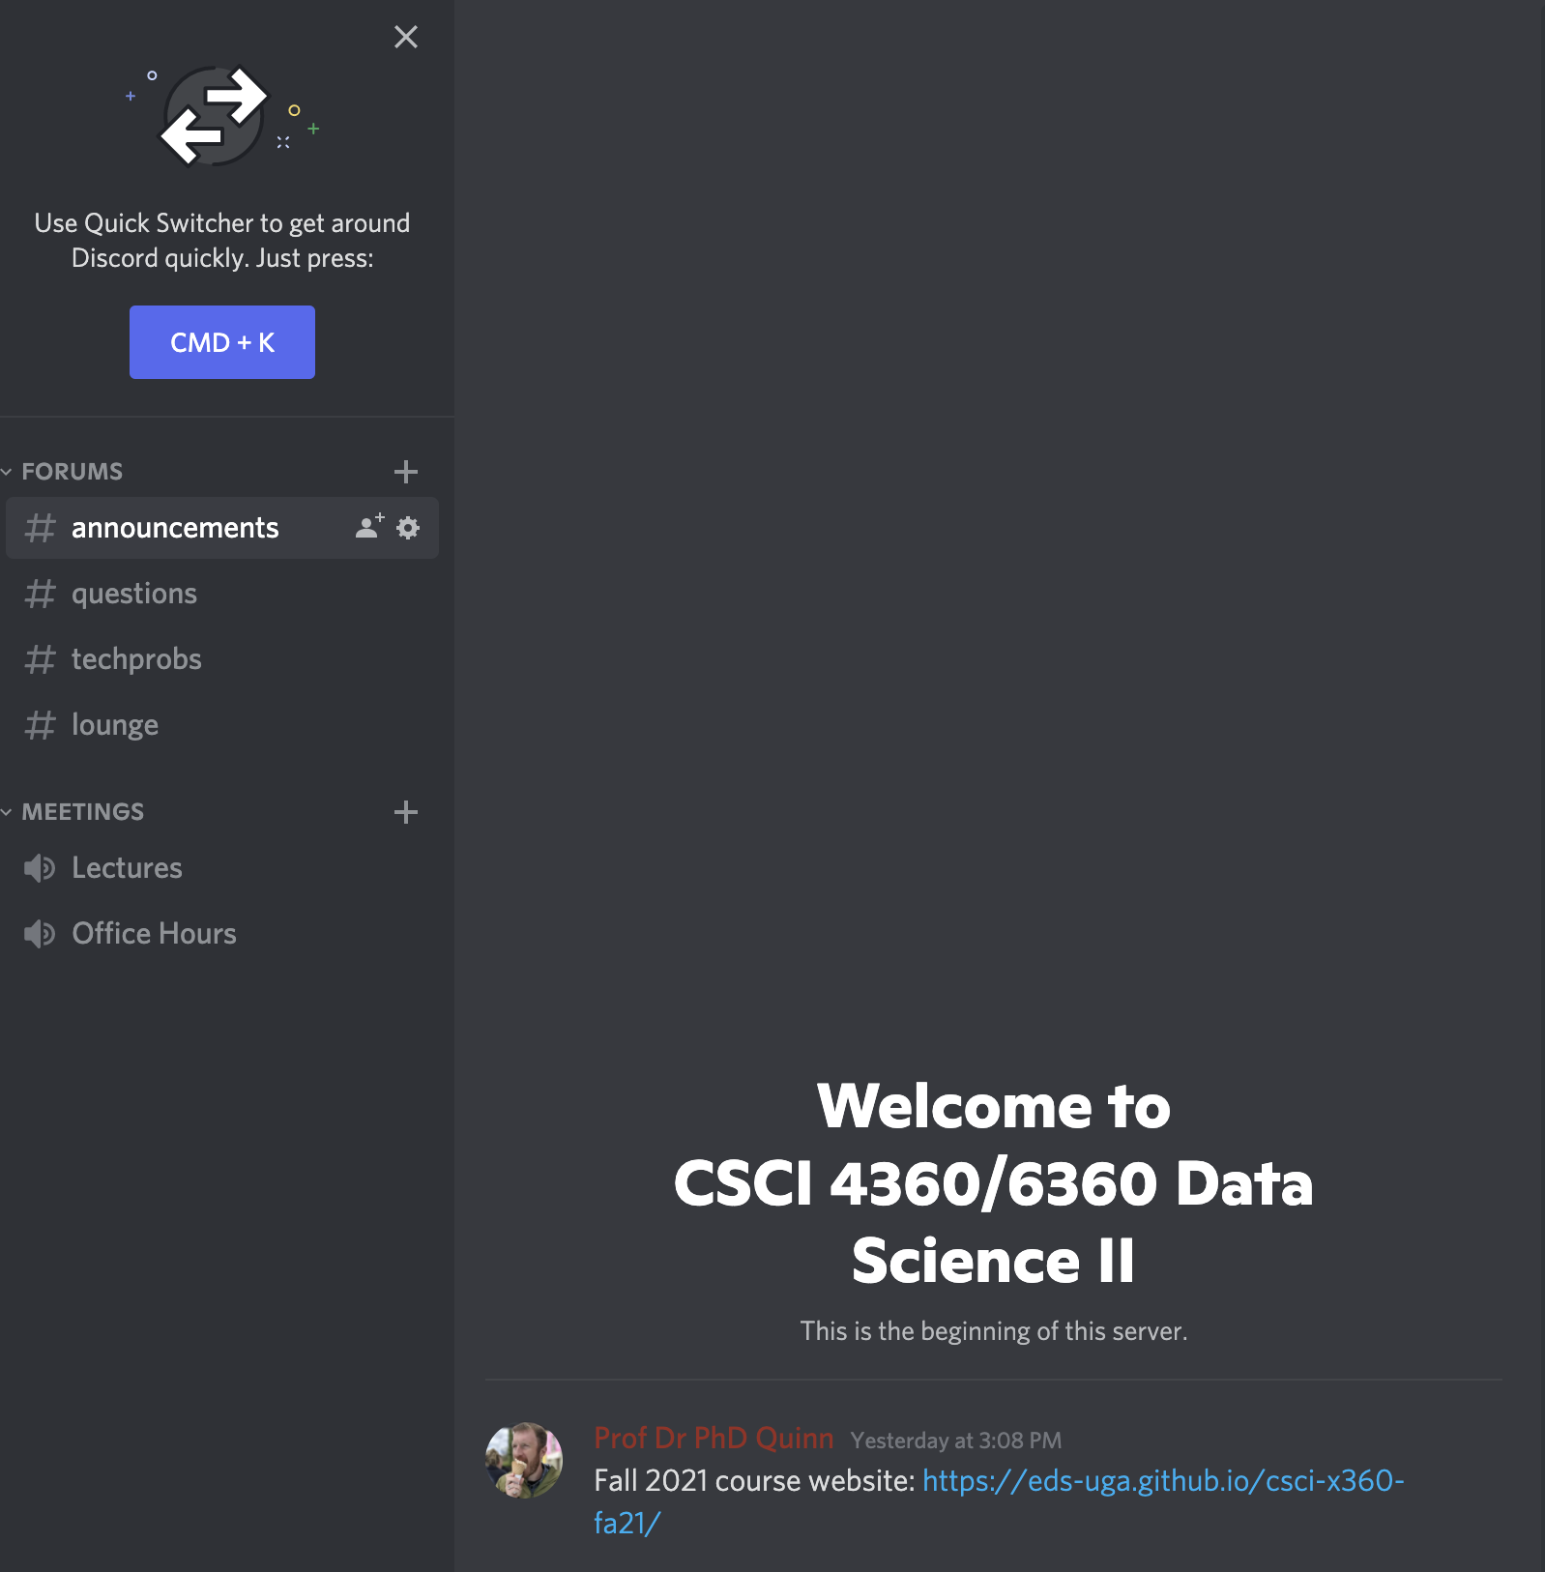
How?
Discord

Slide 10
How?
Discord: post in #questions
If you’re having an issue with course infrastructure, use #techprobs
Email: squinn@cs.uga.edu
I get tons of emails every day
Discord will not only likely get a faster response, but the TA and your fellow students could probably also answer even more quickly

Slide 11
Honesty at UGA
I’d like to think I don’t have to justify this
There’s an official UGA Honesty Policy https://ovpi.uga.edu/academic-honesty/academic-honesty-policy
I use code-checkers
It’s way easier than you think to spot copied code
The official policy in this class: Discuss ideas and concepts with your classmates (or anyone!). Write the code yourself (unless you’re on a team).

Slide 12
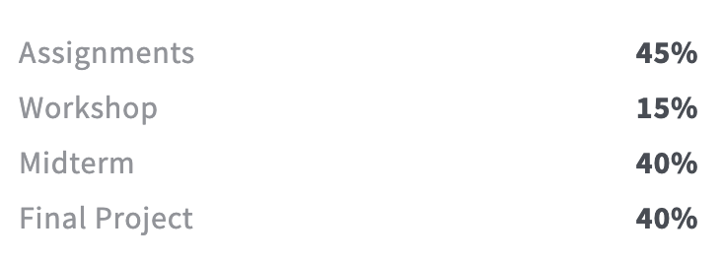
Grading Breakdown

Slide 13
Assignments
There will be 5; you choose and complete 3
Each will be worth 15% of your grade
Doing more than 3 is extra credit
Each will be 2.5 weeks long
Released on a Tuesday morning, due on Thursday evenings by 11:59:59pm
Will likely entail a written and a programming portion
Coding in Python
Writing in Word or LaTeX—nothing handwritten!
All deliverables will be submitted through ?????
More details to come!

Slide 14
Workshops
Most Mondays, we’ll have a workshop
This is student-led and organized
If you’re in 4360, you have to do one
If you’re in 6360, you have to do two
The objective of each workshop is to demo a proof-of-concept
This can be
implementing a topic we covered in class
demonstrating how to use a tool that would help with the topics we’re covering
some other neat course-related use-case
Recommended topics are linked on the course website!

Slide 15
Midterm exam
It’s an exam that happens near the mid-term (Oct 12), what more do you want?
(details will be released later)

Slide 16
Final Project
Teams (of 2-3 students, ideally) will work on a specific data science question
Three components:
The proposal, which outlines the team you’ll work with, the question you’ll address, and the methods + tools you’ll use to address it
Project updates, at least two of them a few weeks apart, which formally lay out your progress, any roadblocks and workarounds, and changes to your original goals
The presentation, where you talk about how awesome your problem is and how you and your team killed it dead (or have almost done so)
More details to come!

Slide 17
Midterm or Final
Choose one
Midterm exam (Oct 12)
Final project
Doing both is extra credit

Slide 18
”Homework 0”
Accept the invitation to Discord if you haven’t already
… o_o
Put together groups of 2-3 students and pick a date + topic for a workshop (see the course website for available dates)
Try to tie in with the lecture material surrounding that date, if possible
First [student-run] workshop is Monday, Aug 30!
Sign up here: https://docs.google.com/spreadsheets/d/1S9fuFx47iEiB5z0grZURiRu7aBYdiB3bGUPmob25zyw/edit?usp=sharing
Homework 1 comes out next Tuesday!

Slide 19
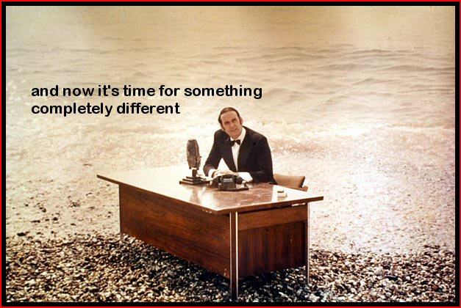

Slide 20
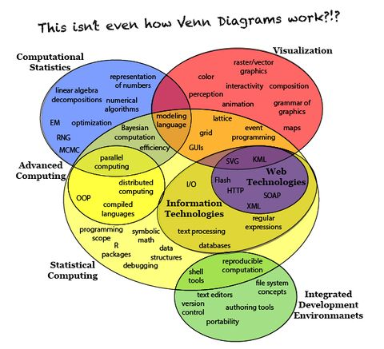
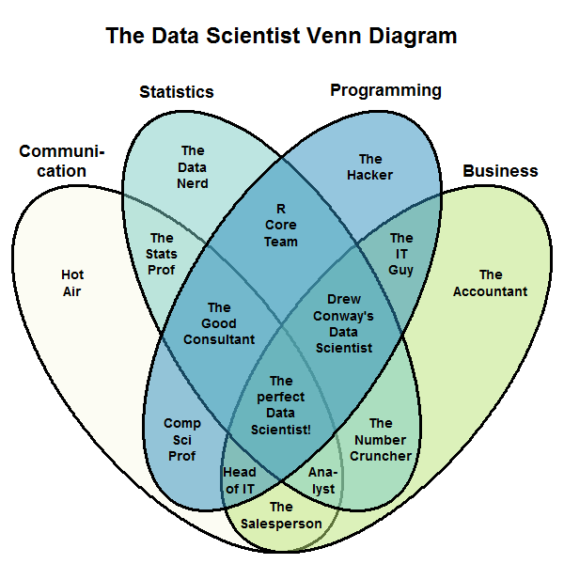
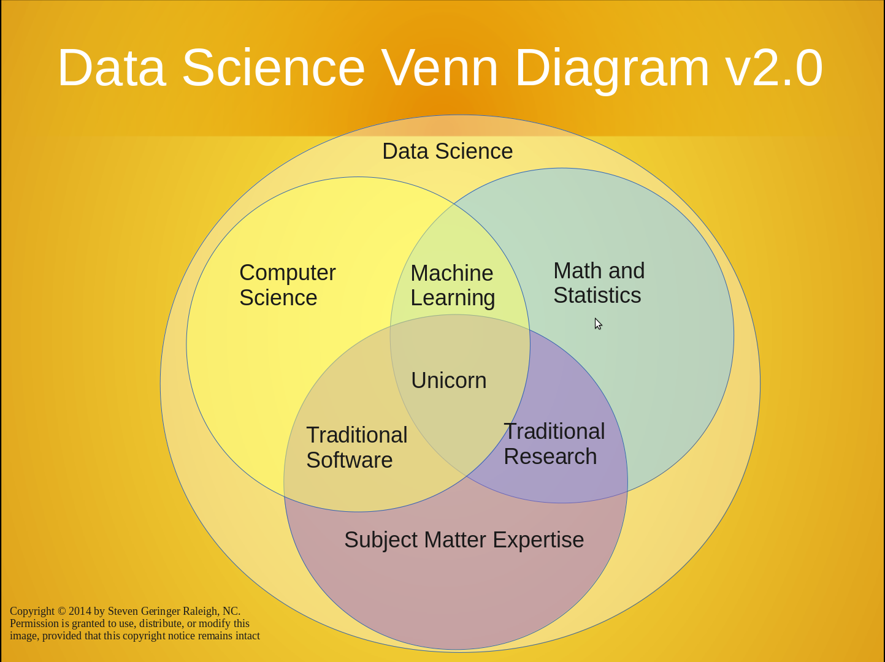

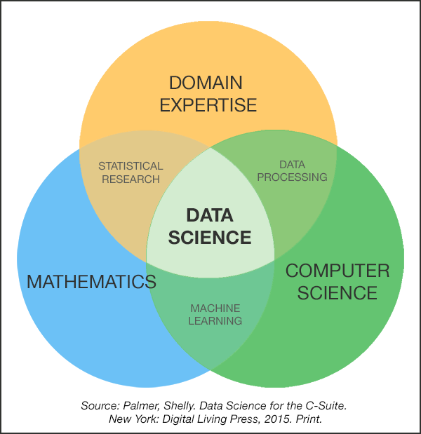
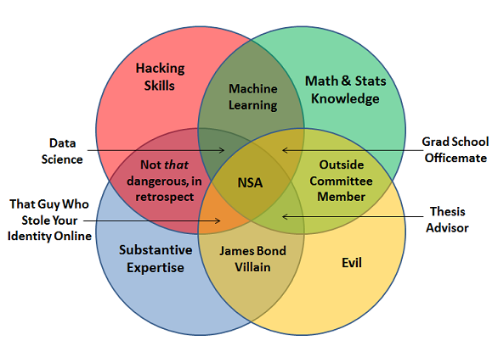
What is “data science”?
It’s a field singularly devoted to bringing back the Venn Diagram

Slide 21
What is “data science”?
From Wikipedia (emphasis mine):
Data science, also known as data-driven science, is an interdisciplinary field about scientific methods, processes, and systems to extract knowledge or insights from data in various forms, either structured or unstructured, similar to data mining. Data science is a "concept to unify statistics, data analysis and their related methods" in order to "understand and analyze actual phenomena" with data. It employs techniques and theories drawn from many fields within the broad areas of mathematics, statistics, information science, and computer science, in particular from the subdomains of machine learning, classification, cluster analysis, data mining, databases, and visualization.

Slide 22
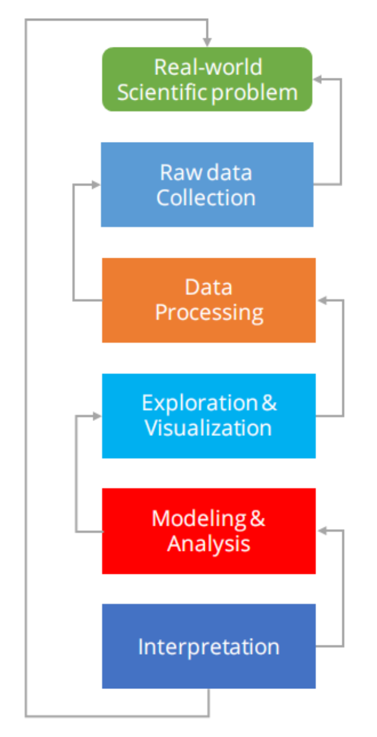
What is “data science”?
If you want my opinion: Dr. Lee nailed it in CSCI 3360
Data Science encompasses the entire problem stack
Problem definition
Data collection & cleaning
Exploration
Modeling
Interpretation & insights

Slide 23
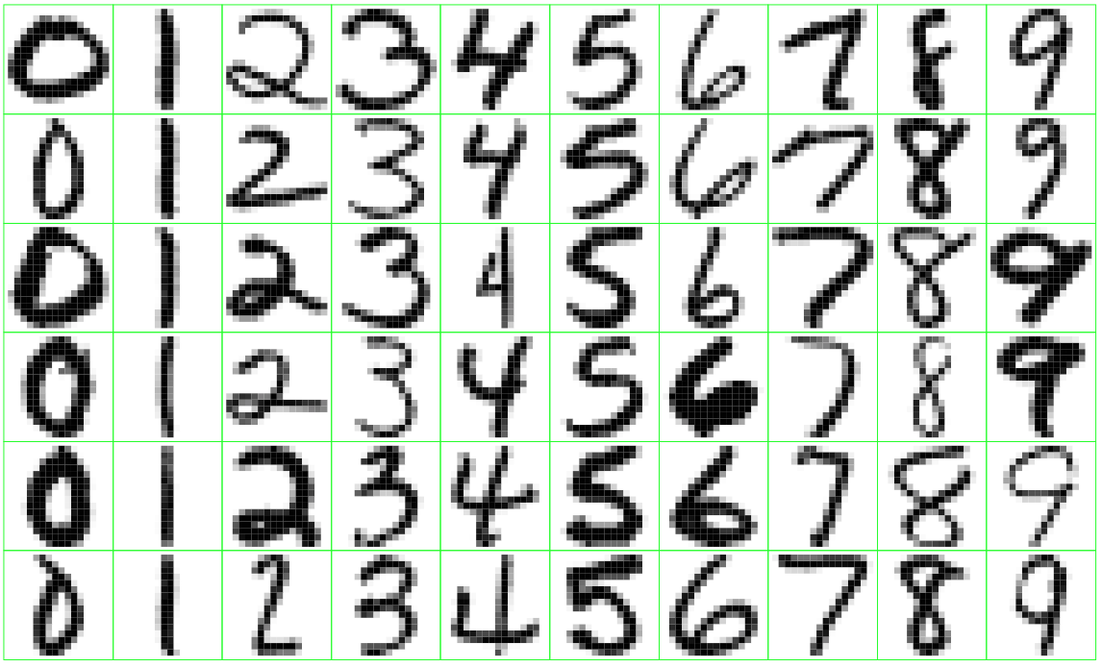
Data Science in practice
Can we automatically sort mail based on ZIP code?

Slide 24
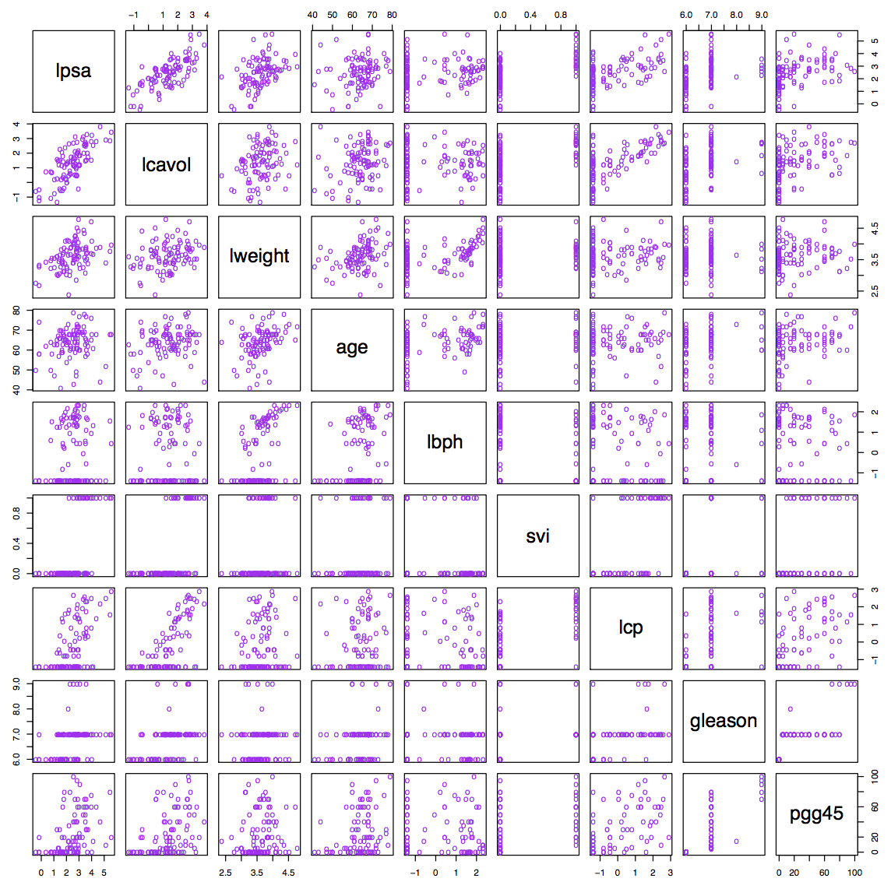
Data Science in practice
What features of prostate cancer are indicative of production of specific antigens?

Slide 25
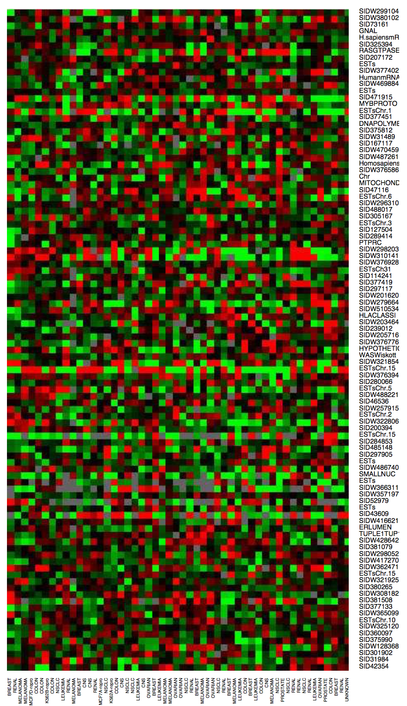
Data Science in practice
Which genes are overactive or underactive in cancer patients?

Slide 26
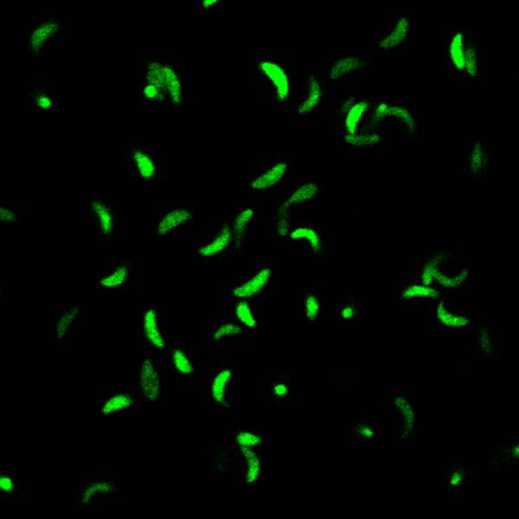
Data Science in practice
What factors determine the movement of the Toxoplasma gondii parasite?

Slide 27
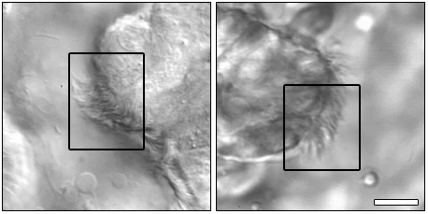
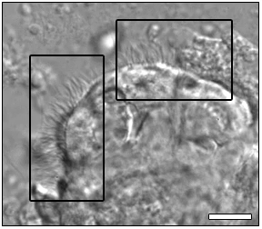
Data Science in practice
How is the motion of cilia associated with and indicative of specific pathologies?

Slide 28
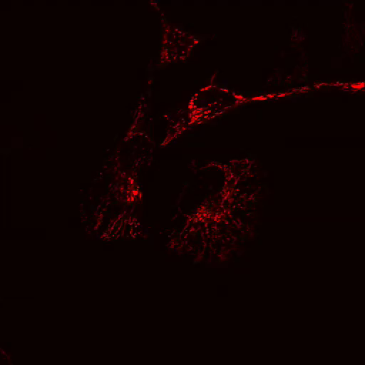
Data Science in practice
What are the protein patterns of mitochondria under different conditions, and how do these changes take place?

Slide 29
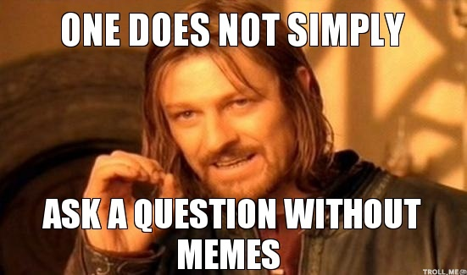
Questions?

Slide 30
Next week
Workshop 0, on using the Anaconda distribution for installing and configuring your own Python environment! (far and away the easiest way to get up and running with Python)
Python crash course

